Slide 1
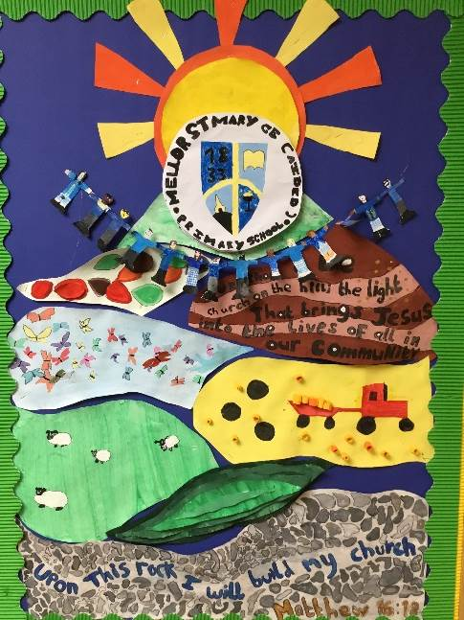

meet the teacher
Class 5
Mr Blackburn, Mrs wells, and
Miss woody

Slide 2
All about Me
My name is Chris Blackburn. I have been a teacher for over 20 years in various schools across Blackburn with Darwen, Lancashire and Australia.
Before I was a teacher, I used to work on survey ships mapping the sea bed.
My favourite subjects are geography and PE.
I have a great passion for travel and love to visit new places. I also love taking part in different sports, especially triathlons.

Slide 3
Priorities in Year 6
Smooth Transition – all roads lead to High School – want children to be well prepared.
Independence skills – use different methods, take more ownership of their own learning.
SATS Companion – helps them to target areas that they find difficult.
Whole school responsibilities

Slide 4

RULES & Routines
School starts at 8.45, arrive from 8.30 – Arithmetic & SATS Companion
Finish at 3.15pm
Playtime at 10.30 - 10.45am.
Lunch 11.45 - 12.45.
Monday – Miss Woody – Art/DT, French
PE – Wednesday and Thursday

Slide 5
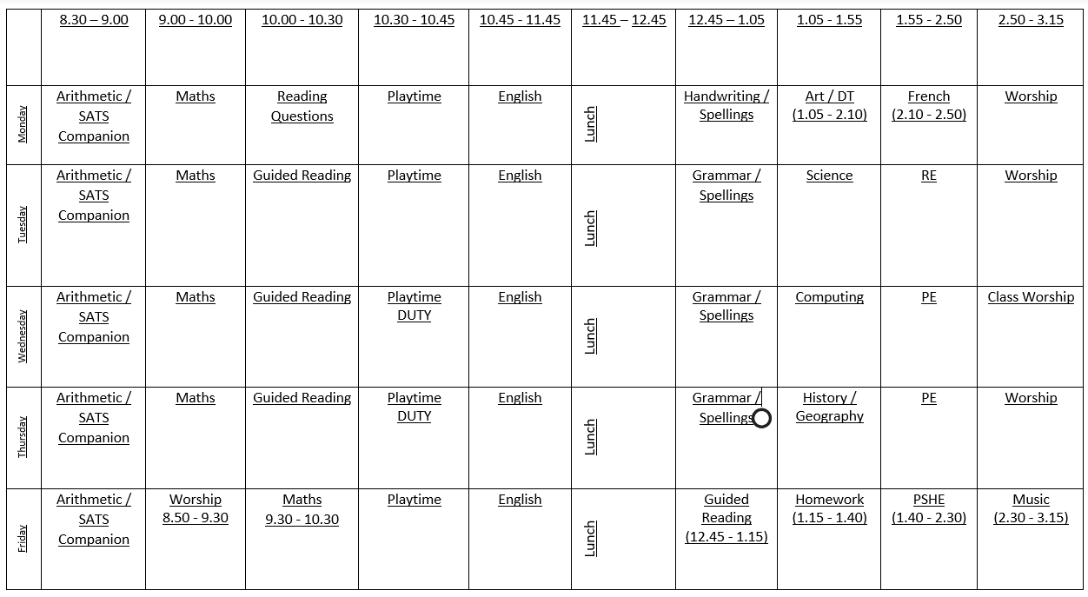
Time table
Notes:
please ensure all kit is in school for these days. Missing kit will mean a yellow card. Continued missing kit will result in a red card. The correct kit is essential for PE.
Trainers will be used for the Mellor Mile which we will do every day at 2pm even in muddy weather and drizzle.
Physical activity has proven scientific results to show it helps children to learn.

Slide 6
CURRICULUM
Three main key questions that we follow...
Autumn Term – Who are we?
Spring Term – Does the punishment fit the crime?
Summer Term – How did the Vikings shape England?
More details in the curriculum overview – given out tonight or to your child tomorrow and put on the website.

Slide 7
marking & Feedback
Written
Verbal and non- verbal
Demonstration – could be with individual, group or whole class
Adaptive teaching and learning sequence
Peer marking and self assessment against learning objective/ success criteria.
Notes:
Written ( limited prose, code, ticks) – marking policy
Marking will also be done verbally with pupils especially during 1 to 1 or guided reading time
Teaching will be suited for each child in year 4 and 5
Peer marking and self assessment and editing so the children can correct their own mistakes and learn from them.

Slide 8
SAT’S
Take place between Monday 10th and Thursday 13th May 2027.
6 Papers
- Grammar (50 questions – 1 mark each)
Spelling (20 spellings)
- Reading (3 texts – 50 marks)
- Maths – Paper 1 Arithmetic (40 marks)
- Maths – Paper 2 Reasoning (35 marks)
- Maths – Paper 3 Reasoning (35 marks)
Writing / Science – teacher assessment & moderated
PLEASE DO NOT USE ANY OF THE REAL PAST PAPERS AT HOME AS WE USE THEM IN SCHOOL. I will add a list of websites with papers that you can use instead. Thank you!
Notes:
Written ( limited prose, code, ticks) – marking policy
Marking will also be done verbally with pupils especially during 1 to 1 or guided reading time
Teaching will be suited for each child in year 4 and 5
Peer marking and self assessment and editing so the children can correct their own mistakes and learn from them.

Slide 9
Reading
Class reading books – opportunities to read daily
Home reading books – read regularly and complete reading record – children are welcome to sign – if you could occasionally comment in it, to show you are sharing reading with them that would be great.
Guided reading – 4 times per week – work on many different reading skills including understanding and inference.
Comprehension skills – sets of questions to complete in class regarding a book that they have read.
Notes:
Changed on Mondays or when the children have finished their books. Reading logs can be used to give information and will be checked if written in and placed in the box.
Guided reading children read in a group twice a week and independent reading 3 x per week.
Silent reading to take place after lunch time for 10 minutes.
Reading is important even if children are fluent readers – learning comprehension skills.

Slide 10
Homework &
GOOGLE CLASSROOM
Daily reading (at least 3 times written in their book)
Spellings – patterns and rules taught through the texts that we are studying.
Include 5 personal words and 5 class words
Maths – provided in maths homework book.
Set on a Friday and to be completed by the following Thursday.
Times Tables Rockstars / SATS Companion
Additional writing/grammar may be set where appropriate and will increase slight as the year goes on.
Notes:
Parents oversee their children’s work and can support it but should not be tempted to complete it for them. If a child struggles with a piece of homework or new reading book parents or carers can see the class teacher.

Slide 11
Responsibilities
New team leaders
School Council
Eco Warriors
Sports Crew
Wellbeing Warriors
Buddies
Playleaders
Class Jobs

Slide 12
Reward Scheme
New and just introduced to the children in the last couple of days.
5 teams – which are habitats – Rainforest, Desert, Grassland, Tundra and Mountains.
Work as a team throughout school to collect cubes.
Move around a cyclindrical track in steps of 100. When they reach a new habitat (every 5oo cubes) they win a reward.
Rewards – hot chocolate, ice pop, computer time, special playtime with equipment, non-uniform day, mini disco in the hall.

Slide 13
Reminders
No jewellery / make up – eye lash curlers
PE Kit in School every day
Homework by Friday
Read everyday – as much as possible
School Website – more information

Slide 14
Transition
Visits from high school teachers
Cluster schools take part in a day of activities in mixed groups
Cathedral Service – Chip party!
Visit from specialist transition staff who look at timetables, packing bags
Lots of work in class preparing mentally as well as academically
Notes:
Class pages – specific to class , homework grids, spelling lists and links to website for homework will be added. Aim to have this completed within the next week.
Worship will be linked to activities from school

Slide 15
Special year 6
Buddies
Benches in assembly
Tower Wood
Cathedral
Sports Day water fight
Leaving hoodies!
Shirt Signing
Leavers service
Year 6 Production
Notes:
Class pages – specific to class , homework grids, spelling lists and links to website for homework will be added. Aim to have this completed within the next week.
Worship will be linked to activities from school

Slide 16
Any Questions?
Thank you
Mr blackburn
cb@mellor.lancs.sch.uk
Notes:
I have created a page about me and my backgrounds and also would like to know some information about your own child if you could fill it in an get it back to me I would really appreciate it so I can get to know your child a bit better and help them learn and progress in their way.

