Slide 1

READING AND SPELLING IN KS2

Slide 2
READING IN KS2
Children from Year 3 up to Year 6 need to continue to have reading at the centre of all of their learning. Being able to decode accurately and read more fluently, they build on these foundation skills.
Comprehension and understanding characters and events and information becomes the reason that they read.
Children read in school across the curriculum in all areas and will need to practise new skills that they have learnt, at home.
Questions can be asked before, during and after reading.
These questions are based around the skills that we are learning in school.

Slide 3
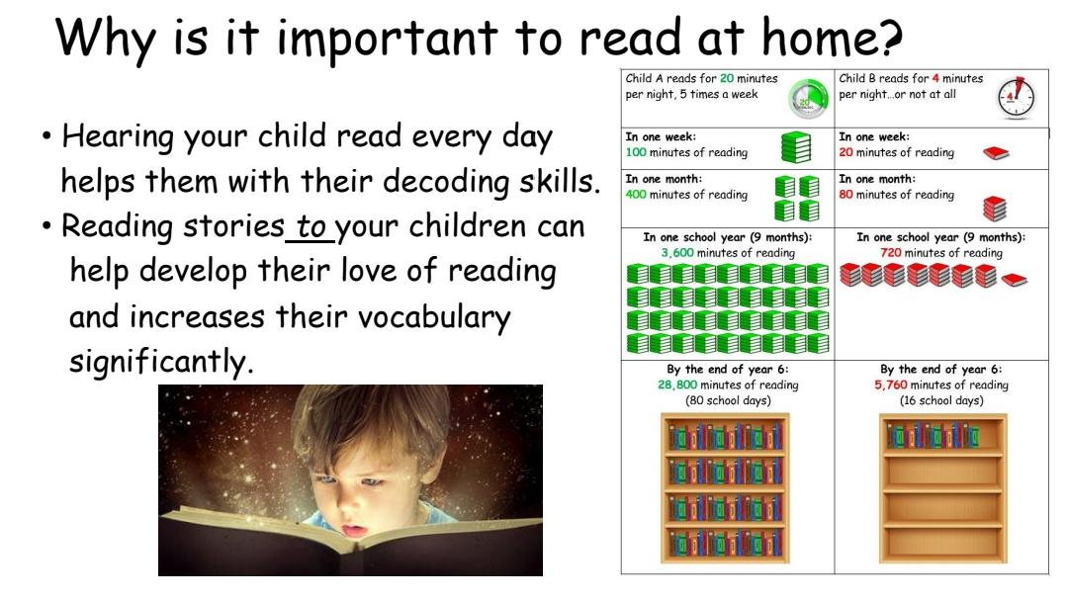

Slide 4
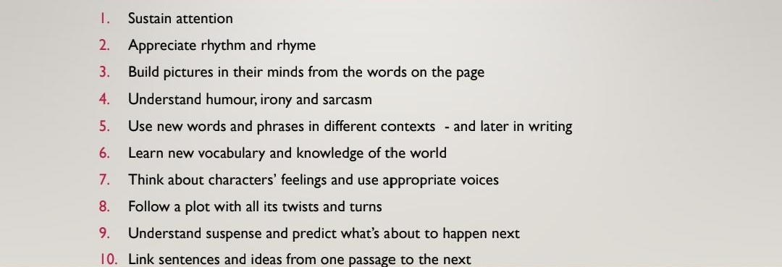
10 THINGS YOUR CHILD LEARNS WHEN YOU SHARE IN READING AND POETRY WITH THEM.

Slide 5
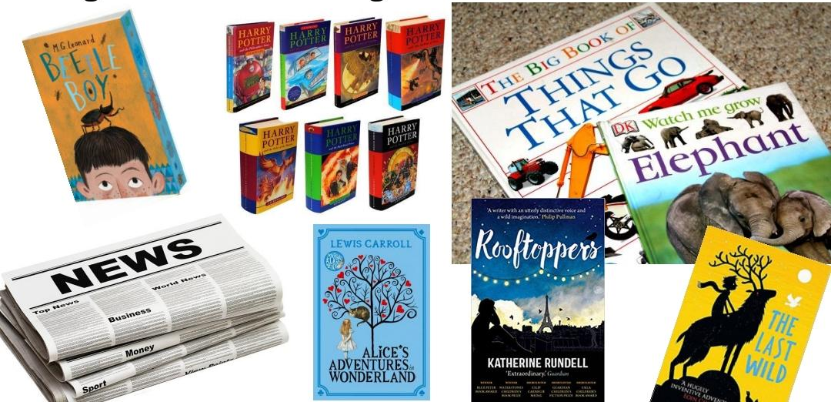
RANGES OF TEXTS AND GENRES

Slide 6
SPELLING IN KS2
Still using phonics but look at spelling rules
More emphasis on rules
Making connections – etymology
Spelling league
variety

Slide 7
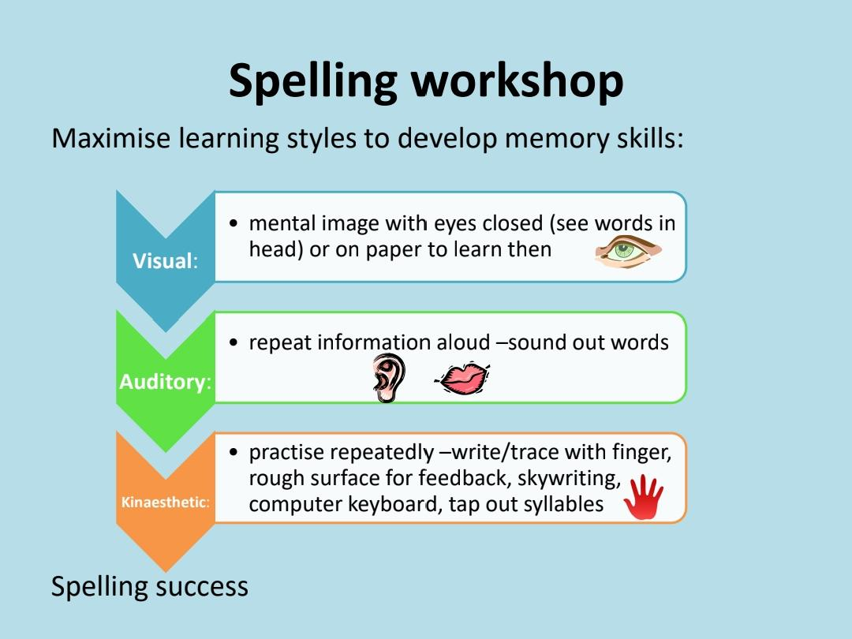

Slide 8
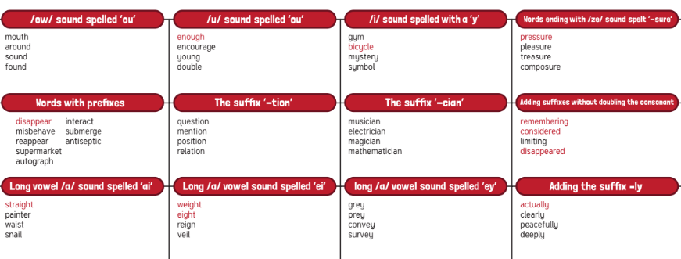
SPELLING RULES
There are many rules that we teach in KS2

Slide 9
ETYMOLOGY
Etymology is the origin and history of words and is an important part of learning to spell in ks2.
cent – 100 in latin – century, centimetre, percent
Etymology
Study of the history of words, their origins, and how their form and meaning have changed over time

Slide 10
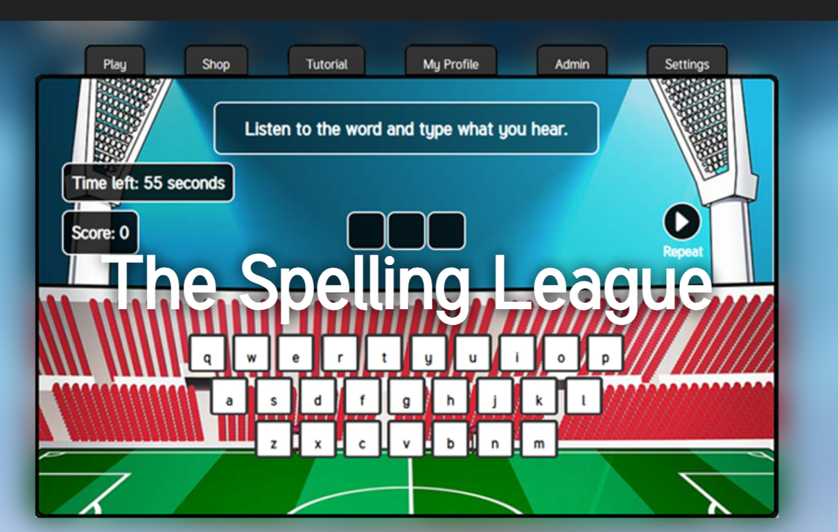
SPELLING LEAGUE

Slide 11
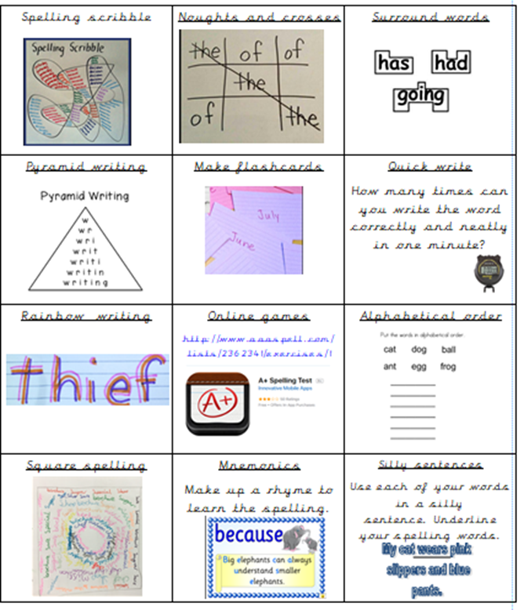
VARIETY
Some children learn spellings in different ways maybe visually and maybe hands on .

Slide 12
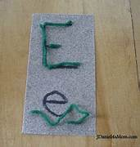
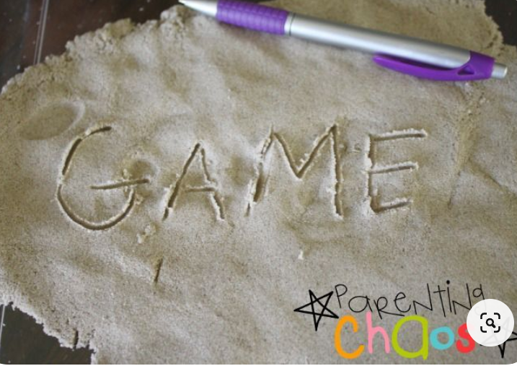

Slide 13
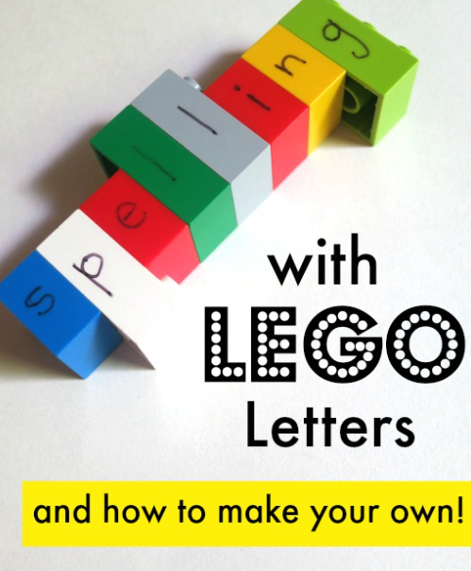
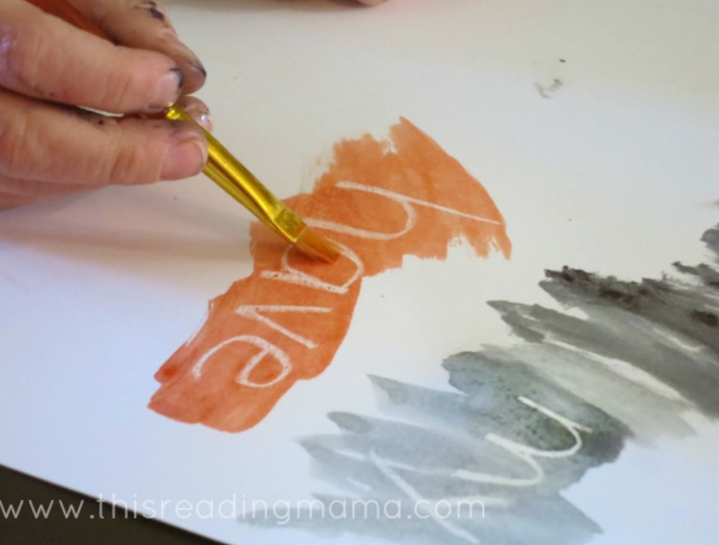
https://thisreadingmama.com/hands-on-spelling-activities/

