Slide 1
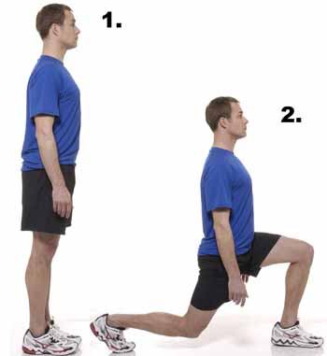
Lunges
Quadriceps
Gluteus Maximus
Key Points
Keep back straight.
Shoulders back.
Head facing forward.
Step forward with one leg.
Bend back leg to 90 degrees.
Progression!
Alternate Jump Lunges!

Slide 2
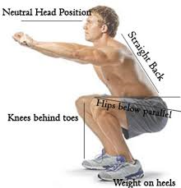
Quadriceps
Gluteus Maximus
Squats
Key Points
- Neutral head position
Straight back.
Hips parallel or below!
Knees behind toes.
Weight on heels.
Progression!
Jump Squats!
Squat with your partner on your back!

Slide 3
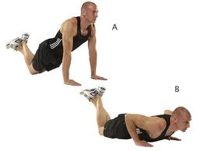
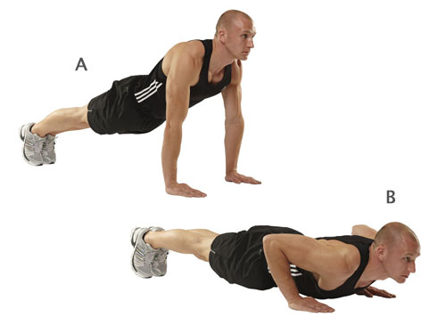
Triceps
Pectorals
Press Ups
Key Points
- Head facing forward.
Straight back.
Bend elbows and lower chest to the floor.
Push back up to starting position.
Easy: Start from knees.
Harder: Start from feet.
Insane: Press up with front clap!

Slide 4
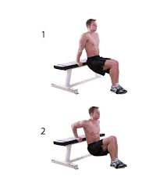
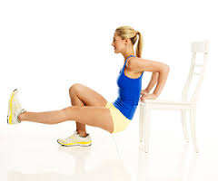
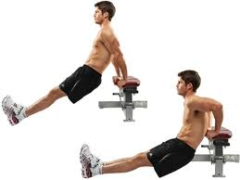
Triceps
Pectorals
Tricep Dips
Key Points
Place hands on bench with fingers facing forwards.
Straighten legs so only heels are touching the floor.
Bend elbows to lower buttocks to the floor.
Push back up so elbows are straight.
1
3
2
No. 1 = Easy
No. 2 = Hard
No. 3 = Insane!

Slide 5
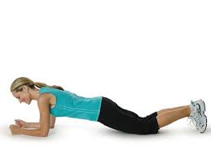
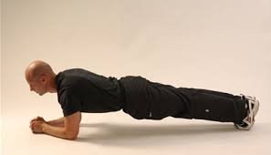
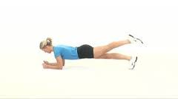
Abdominals
Lower Back
Plank
Key Points
Lay on your front and place your forearms and palms flat on the floor.
Lift your chest, stomach and legs off the floor and maintain balance on forearms and toes.
Keep a straight, flat back.
1
2
No. 1 = Easy
No. 2 = Hard
No. 3 = Insane!
3

Slide 6
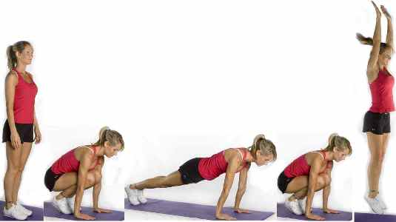
Full Body
Cardiovascular Fitness
Burpees
Key Points
Squat down.
Kick feet back.
Chest to floor.
Return to squat position.
Jump!
Progression!
Add a press up!
Do this on a crash mat!

Slide 7
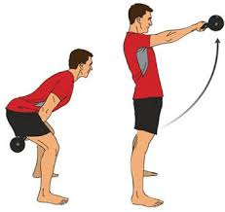
Gluteus Maximus
Lower Back
Kettle Bell Swings
Key Points
- Weight on heels.
Keep back flat at all times, chest up!
Squat down and bring the kettle bell between your legs.
Snap the hips forward and stand tall.
Could be done using a can or other weighted object.

Slide 8
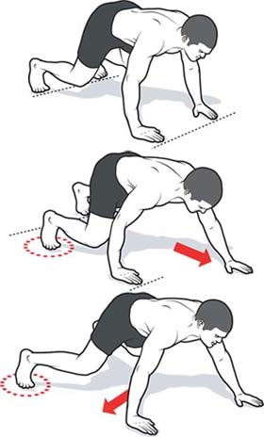
Whole Body Exercise
Muscular Endurance
‘Bear’
Crawls
Key Points
-Head facing forwards at all times.
Straight back at all times.
Crawl forwards, opposite hand to opposite leg.
Progression!
Add a press up on each movement!

Slide 9
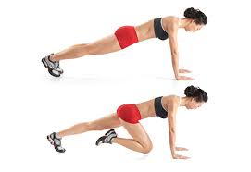
Cardiovascular Fitness
Muscular Endurance
Mountain Climbers
Key Points
Begin in the press up position.
Straight back at all times.
Drive knee to the chest (one leg at a time).
This can be performed with hands on a bench.
Progressions!
1) Single leg out to the side.
2) Rotate single leg in a circular motion (then swop!)

Slide 10
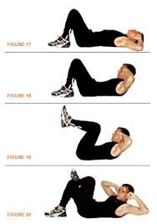
Abdominals
Hip Flexors
Ab Crunches
Key Points
Raise knees and fixate hips.
Raise shoulders off the floor (only go half way!)
Lower shoulders back to the floor and repeat!
Progressions
1) Raise legs to 90 degrees whilst performing the sit up.
2) Place one leg across the other and add a twist in the sit up.
1
2

Slide 11
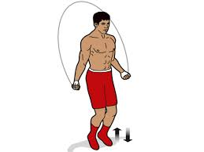
Cardiovascular Endurance
Muscular Endurance
Skipping
Key Points
Hold the skipping rope by the handles.
Start with your hands in front of your body but the rope behind your feet.
Throw the rope over your head and jump just as the rope hits the floor.
Try maintain a rhythm for this one!

Slide 12
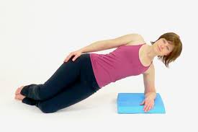
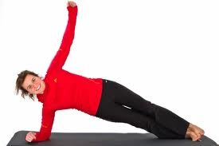
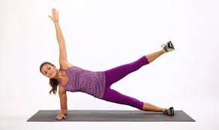
Abdominals
Oblique's
Side Plank
Key Points
- Lay on your side and place forearm 90 degrees on the floor.
Lift your upper body supported either by feet or knees.
Keep body straight and stable.
1 = Easy
2 = Hard
3 = Insane
Further Progression!
Twist free arm underneath the body!

Slide 13
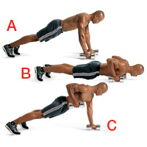
Pectorals
Muscular Endurance
Weighted Press Up
Key Points
Head facing forward, straight back (press up position).
Complete a press up.
As you return to the press up position, lift one arm at once so the elbow reaches 90 degrees.
Repeat!
Start on knees and progress up to a full press up!

Slide 14
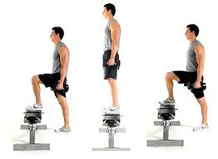
Cardiovascular Endurance
Muscular Endurance
Step Ups
Key Points
Head up and a straight back at all times.
Step onto the bench (make sure both feet go on the bench).
Then step off the bench one foot at a time.
Do this as fast as you can!
Progressions!
Have weights in each hand.
Toe taps on the bench.

Slide 15
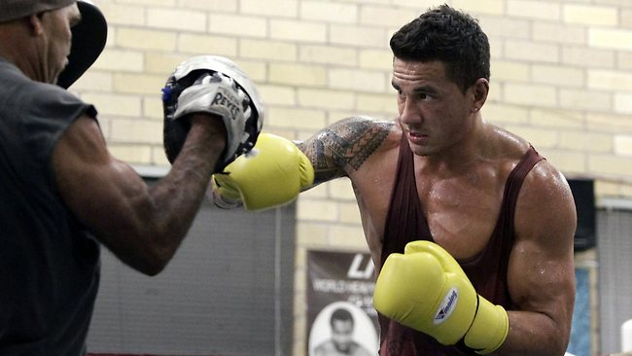
Cardiovascular Endurance
Muscular Endurance
Pad Work
Key Points
Work in pairs.
Stay on your toes.
Fast and powerful punching.
Alternative arms.
Do this as fast and as precise as you can!

Slide 16
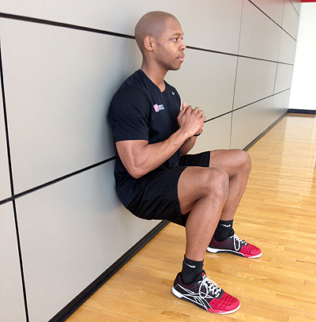
Cardiovascular Endurance
Muscular Endurance
Wall Sit
Key Points
90 angle at the knee.
Feet shoulders width apart.
Arms out in front of chest.
Back straight against the wall.

