Slide 1
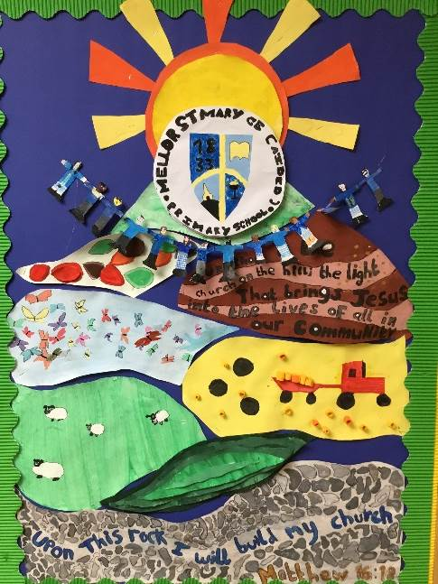

meet the teacher
Class 3
Mr Blackburn
MRS FIELDING
Mrs Oddie
MRS HOUNSLOW

Slide 2


Welcome to class 5
Running Order...
Growth Mindset
Rules and Routines
Reading
Homework
Marking & Feedback
Clubs and Activities
School Website
Questions
Notes:
Rules and routines – class contract, traffic light system, behaviour policy.
Rewards and sanctions – red = five minutes playtime, rewards = marble rewards, gold tin, stickers, house points
Growth mindset board – resilience, board for the children.
Reading books – library books, reading books and records – reading at home- newspapers, comics, library books, books from home.
Homework -
Marking and feedback – green pen – fix it time every morning children expected to respond- presentation policy and finishing work at playtimes.
Clubs and activities - Mondays - Tuesdays- Wednesdays – Thursdays – Urban Art club Friday –
School website -

Slide 3

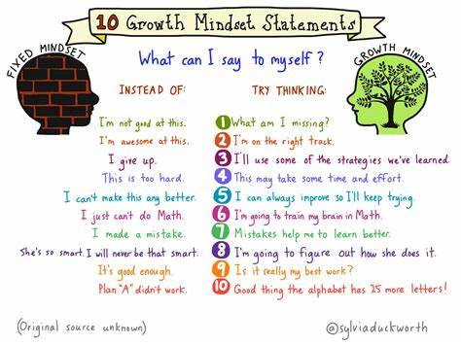
Growth Mindset
https://www.youtube.com/watch?v=M1CHPnZfFmU

Slide 4
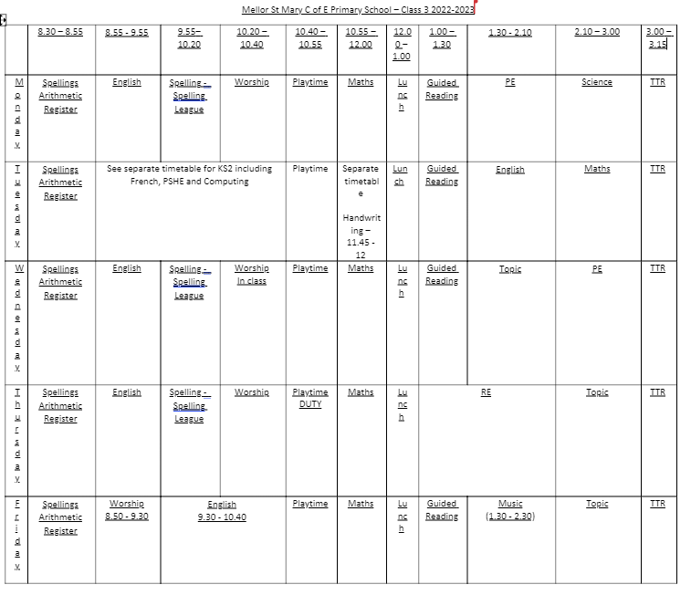
Time table
Notes:
please ensure all kit is in school for these days. Missing kit will mean a yellow card. Continued missing kit will result in a red card. The correct kit is essential for PE.
Trainers will be used for the Mellor Mile which we will do every day at 2pm even in muddy weather and drizzle.
Physical activity has proven scientific results to show it helps children to learn.

Slide 5
RULES & Routines
School starts at 8.45, arrive from 8.30.
Morning - spellings and arithmetic challenge
Playtime at 10.40am - 10.55am. Afternoon - optional
Lunch 12noon – 1.00pm.
Finish at 3.15pm
Tuesday – PSHE / Computing and French
Thursday - Mrs Oddie and Mrs Hounslow
PE – Monday and Thursday (subject to change

Slide 6
Rules & Routines
Rewards – House points / Certificates / Marble Jar – Class treat
Sanctions – Behaviour Policy
No jewellery

Slide 7
Reading books
Class reading books – 15 minutes a day
Home reading books
Sent home once a week. As they are getting longer take more time to read. Get children to think deeper into the books. Character descriptions, drawing the setting, book reviews etc. List on the website.
Please return these on the day on your book. It makes it easier to change. Please write in the books, each time you look at it so that we can see the different things that you have done.
Guided reading - 4 times per week
Notes:
Changed on Mondays or when the children have finished their books. Reading logs can be used to give information and will be checked if written in and placed in the box.
Guided reading children read in a group twice a week and independent reading 3 x per week.
Silent reading to take place after lunch time for 10 minutes.
Reading is important even if children are fluent readers – learning comprehension skills.

Slide 8
Homework &
GOOGLE CLASSROOM
Daily reading
Spellings – Friday to Friday – apply in a sentence at the end of the week.
Times Tables Rockstars
Homework will be on Google Classroom – Set on a Monday and expected by the following Monday. One piece of English and maths, linked to the work we have been doing in class.
One creative piece of homework, linked to our topic in class. This will be set on a two weekly basis.
Help and support – ask if needed
Notes:
Parents oversee their children’s work and can support it but should not be tempted to complete it for them. If a child struggles with a piece of homework or new reading book parents or carers can see the class teacher.

Slide 9
marking & Feedback
Written
Verbal and non- verbal
Demonstration – could be with individual, group or whole class
Adapted teaching and learning sequence
Peer marking and self assessment against learning objective/ success criteria.
Notes:
Written ( limited prose, code, ticks) – marking policy
Marking will also be done verbally with pupils especially during 1 to 1 or guided reading time
Teaching will be suited for each child in year 4 and 5
Peer marking and self assessment and editing so the children can correct their own mistakes and learn from them.

Slide 10
Clubs & Activities
Breakfast and after school clubs.
Trips will be planned and linked to the topic as much as possible.
It is extremely important that all contact details are up to date, including email and mobile phone numbers for all people responsible for collecting pupils from school.
Notes:
Clubs held in school are –
Trips will be planned asap and parents will be informed as soon as risk assessments have been confirmed
Contact details are very important.

Slide 11
School Website
General information
Class page – Updates on what we have been doing
Worship page (follow up activities to do at home)
‘Kids page’ with information for children to do at home.
Notes:
Class pages – specific to class , homework grids, spelling lists and links to website for homework will be added. Aim to have this completed within the next week.
Worship will be linked to activities from school

Slide 12
Any Questions?
Thank you
Mr blackburn
cb@mellor.lancs.sch.uk
Notes:
I have created a page about me and my backgrounds and also would like to know some information about your own child if you could fill it in an get it back to me I would really appreciate it so I can get to know your child a bit better and help them learn and progress in their way.

